Slide 1

Module 4 Unity 2D Basics and Selection

Slide 2
Content (slot 2)
Putting It All Together
Exercise 12
Exercise 13
Selection Control Structure
Testing Selection Control Structures

Slide 3
4.5 Putting It All Together
Problem description:
Move three teddy bears around the screen until the player quits the game.
Understand the Problem:
What should we do when a teddy bear reaches the edge of the screen?
The teddy bear bounce off the edge of the screen, warp to the other side of the screen, explode and then re-spawn on the screen, and so on.
What should happen when two teddy bears run into each other?
There are lots of possibilities here as well, but let's have them bounce off each other when they collide.
The revised problem description:
Move three teddy bears around the screen, bouncing them off the edges and each other, until the player quits the game.

Slide 4
4.5 Putting It All Together
Design a Solution:
Solve most of this problem using Unity's 2D physics system, with a pretty simple TeddyBear script that we use to start each teddy bear moving.
Write Test Cases:
Write the Code:
To get our teddy bear to obey the laws of physics, we need to add a Rigidbody2D component to the teddy bear game object.
To get the teddy bear moving in the Start method of the TeddyBear script.

Slide 5
4.5 Putting It All Together
Write the Code:
To get our teddy bear to obey the laws of physics, we need to add a Rigidbody2D component to the teddy bear game object.
To get the teddy bear moving in the Start method of the TeddyBear script.
How do we get an object moving in the physical world?
AddForce method of Rigidbody2D: Vector2 and ForceMode2D arguments.

Slide 6
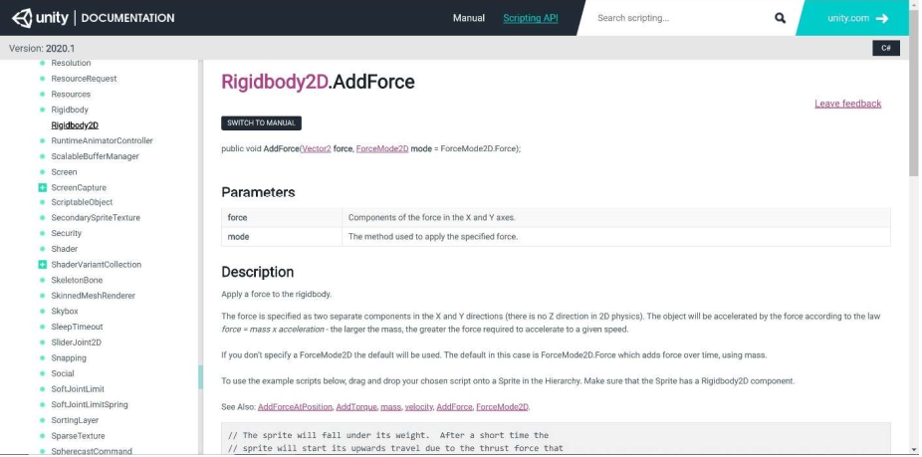
4.5 Putting It All Together
Write the Code: AddForce Documentation

Slide 7
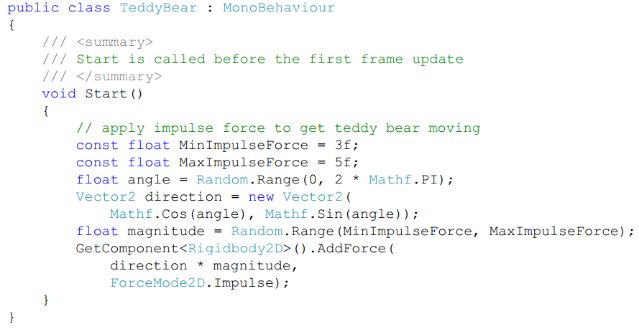
4.5 Putting It All Together
Write the Code: the TeddyBear script

Slide 8
4.5 Putting It All Together
Write the Code:
Add a collider component to the teddy bear game object.
Six kinds of collider listed in order of efficiency for collision detection: Circle Collider 2D, Box Collider 2D, Polygon Collider 2D, Edge Collider 2D, Capsule Collider 2D, and Composite Collider 2D.
Add a Box Collider 2D because that will work well enough for our bouncing around in this game.

Slide 9
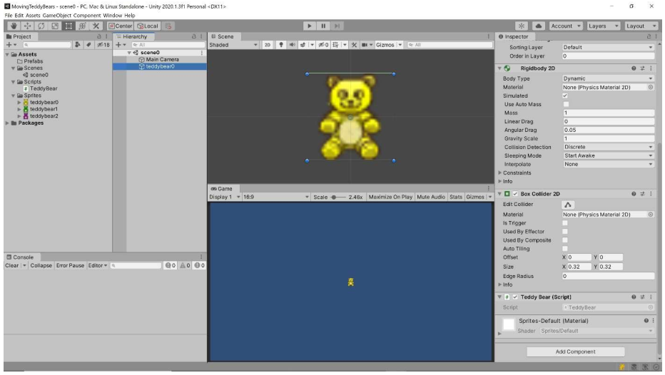
4.5 Putting It All Together
Write the Code: Initial Box Collider 2D

Slide 10

4.5 Putting It All Together
Test the Code:

Slide 11
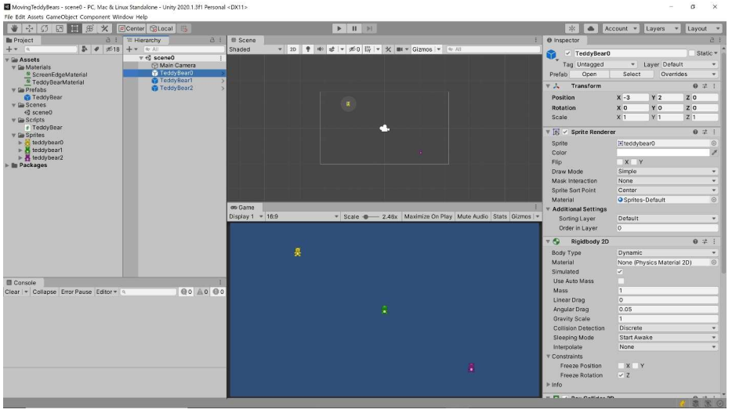
4.5 Putting It All Together
Test the Code: Final MovingTeddies Project

Slide 12
Exercise 12: Move That Game Object
View LMS

Slide 13
Exercise 13: More Unity Practice
Link: LMS

Slide 14
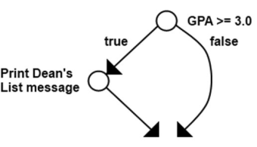

4.6 Selection Control Structure
Example 5.1. Printing a Dean's List Message Problem Description: Write an algorithm that will print a Dean's List message if the student's Grade Point Average (GPA) is 3.0 or above.

Slide 15
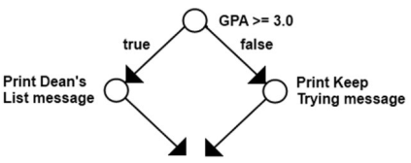

4.6 Selection Control Structure
Example 5.2. Printing a Dean's List or Keep Trying Message Problem Description: Write an algorithm that will print a Dean's List message if the student's GPA is 3.0 or above and will print a Keep Trying message if it's not.

Slide 16
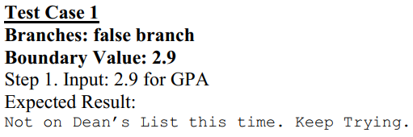
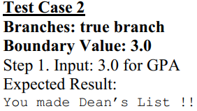
4.7 Testing Selection Control Structures
Test every branch at least once
Example: We run the program with a GPA >= 3.0 and make sure it prints the Dean's List message then we run the program again with a GPA < 3.0 to make sure it prints the Keep Trying message.
Test boundary values in the Boolean expression
Example: try values of 2.9 and 3.0 for the GPA to make sure the program works properly for both of them.

Slide 17
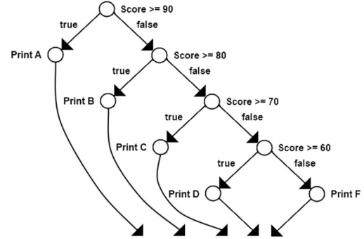
4.7 Testing Selection Control Structures
CFG for Determining and Printing Letter Grade
A set of test cases is a test plan (test suite).

